Slide 1



Development of master curricula for natural disasters risk management in Western Balkan countries
UNIME Student Internships organisation
Dr. Simona Fazio, Ph.D
University of Messina
Project Management Committee – Chania, 6 September 2018
Project number: 573806-EPP-1-2016-1-RS-EPPKA2-CBHE-JP
"This project has been funded with support from the European Commission. This publication reflects the views only of the author, and the Commission cannot be held responsible for any use which may be made of the information contained therein"

Slide 2
UNIME OFFICES IN CHARGE OF INTERNSHIPS MANAGEMENT
Development of master curricula for natural disasters risk management in Western Balkan countries
Orientation & Placement Center (COP)
Internships within the framework of the Italian national and regional legislation
Erasmus Mobility Unit
Internships within the framework of Erasmus+ Programme with Programme Countries (EU Member States)
European Programmes Unit
Internships within the framework of Erasmus+ Programme with Partner Countries (Extra EU States)

Slide 3
UNIME OFFICES IN CHARGE OF INTERSHIPS MANAGEMENT
Development of master curricula for natural disasters risk management in Western Balkan countries
The Unime Offices in charge of Internships management establish and manage relations with businesses locally, nationally and internationally to help introduce students and new graduates to the labour market, offering career advice and orientation.

Slide 4
UNIME INTERNSHIP - HOW DOES IT WORK?
Before
Development of master curricula for natural disasters risk management in Western Balkan countries
Before an internship starts, Unime Offices must ensure that two requirements are fulfilled:
an Inter-institutional Agreement between Unime and the host Company must be signed
A Work Plan/Learning Agreement for traineeship must be signed by the trainee and the Supervisors at both Unime and the host Company

Slide 5
UNIME INTERNSHIP - HOW DOES IT WORK?
Types of internships
Development of master curricula for natural disasters risk management in Western Balkan countries
The Unime Offices in charge of internships management deal with two different types of internships:
Curricular Internships
- are ruled by academic regulation
- take place during a student’s academic career
- aim at creating a time for work-related learning
Non-curricular internships
- are ruled by regional and national legislation
- are designed for graduates
- must take place in the first 12 months after the completion of a degree

Slide 6
CURRICULAR INTERNSHIPS
Development of master curricula for natural disasters risk management in Western Balkan countries
are part of the student’s academic learning plan
take place during the 3rd year of study for Bachelor students and the 2nd year of study for Master students
can last between a minimum of 2 and a maximum of 12 months
don’t foresee any type of financial compensation or support

Slide 7
NON-CURRICULAR INTERSHIPS
Development of master curricula for natural disasters risk management in Western Balkan countries
take place no more than 12 months after graduation
forsee a minumum of 20 and a maximum of 40 working hours per week
forsee a monetary allawance (€300 minimum)

Slide 8
I. ORIENTATION & PLACEMENT CENTER (COP)
Development of master curricula for natural disasters risk management in Western Balkan countries
The Unime Orientation & Placement Center is the office in charge of managing non-curricular interships and curricular interships in partnership with Unime Departments

Slide 9
I. ORIENTATION & PLACEMENT CENTER (COP)
Development of master curricula for natural disasters risk management in Western Balkan countries
The Orientation & Placement Center, in partnership with the Almalaurea Consortium (www.almalaurea.it), can rely on a database of n. 974 host companies
national
International
public
private
Notes:
AlmaLaurea is a Interuniversity Consortium established in 1994 and currently counts 75 Universities as members and represents about 90% of Italian graduates.

Slide 10
I. ORIENTATION & PLACEMENT CENTER (COP)
Development of master curricula for natural disasters risk management in Western Balkan countries
The student can propose a placement at an organisation or business which is not formally included in the Unime database to carry out the internship

Slide 11
I. ORIENTATION & PLACEMENT CENTER (COP)
Internships Data 2016-2018
Development of master curricula for natural disasters risk management in Western Balkan countries
Non curricular internships: 288
Curricular internships in engineering: 586

Slide 12
II. ERSAMUS MOBILITY UNIT
Development of master curricula for natural disasters risk management in Western Balkan countries
The UNIME Erasmus Mobility Unit manages the Erasmus+ for Traineeships Programme with programme countries which enables students enrolled at European higher education institutions to spend a training period at a company or organisation in another participating programme country

Slide 13
II. ERSAMUS MOBILITY UNIT
Objectives
Development of master curricula for natural disasters risk management in Western Balkan countries
To help students to adapt to the requirements of the EU-wide labour market;
To enable students to develop specific skills including language skills;
To contribute to the development of a pool of well-qualified, open-minded and internationally experienced young people as future professionals.

Slide 14
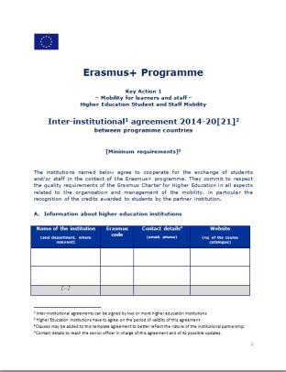
Erasmus+ for Traineeships Programme
Programme Countries – Documents I
Development of master curricula for natural disasters risk management in Western Balkan countries
Before the internship starts:
Inter-institutional Agreement:
between Unime and the host
company
The host company must be located
in a a programme country

Slide 15
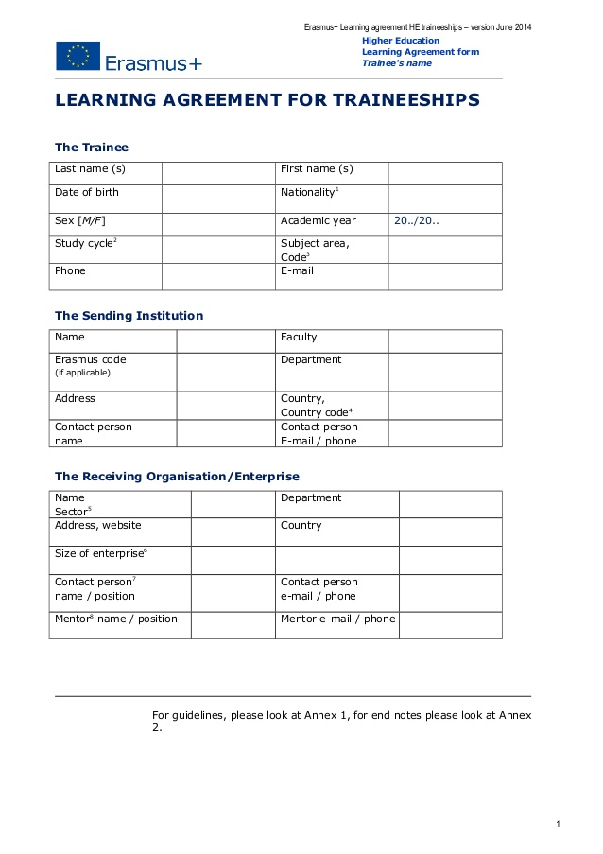
Erasmus+ for Traineeships Programme
Programme Countries – Documents II
Development of master curricula for natural disasters risk management in Western Balkan countries
Learning Agreement:
between the student, Unime and
the host company

Slide 16
Erasmus+ for Traineeships Programme
Programme Countries – Who can take part?
Development of master curricula for natural disasters risk management in Western Balkan countries
Students formally enrolled at Unime (I/II/III cycle of study)
Training can be either for work experience or a research thesis
Training activities must concern the student’s course of study

Slide 17
Erasmus+ for Traineeships Programme
Programme Countries – How does it last?
Development of master curricula for natural disasters risk management in Western Balkan countries
Training period is between 2 and 4 months
Grants are paid by Unime (€400 per month)

Slide 18
Erasmus+ for Traineeships Programme
Programme Countries – After the training…
Development of master curricula for natural disasters risk management in Western Balkan countries
The training can be recognised both as:
curricular intership
non-curricular intership

Slide 19
Erasmus+ for Traineeships Programme
Programme Countries – After the training…
Development of master curricula for natural disasters risk management in Western Balkan countries
The training leads to the automatic recognition of ECTs
curricular internship: prearranged within the study plan
non curricular intership: calculated on the basis of the working days, using the following conversion table
Number of days | ECTs
0 – 5 | 0 ECTs
6 – 16 | 1 ECTs
13 – 20 | 3 ECTs
21 – 30 | 5 ECTs

Slide 20
Erasmus+ for Traineeships Programme
Programme Countries – Internships Data 2016-2018
Development of master curricula for natural disasters risk management in Western Balkan countries
n. 169 internships
n. 7 in Engineering
Host Companies (Engineering): Magma Tech (UK), Imec (Belgium), Centre tecnològic de Catalunya – Universitat Rovira I Virgily (Spain)

Slide 21
III. EUROPEAN PROGRAMMES UNIT
Development of master curricula for natural disasters risk management in Western Balkan countries
The UNIME European Programme Unit manages the Erasmus+ for Traineeships Programme with Partner countries which enables students enrolled at extra European higher education institutions to spend a training period in an enterprise or organization located in a programme country and vice versa

Slide 22
Erasmus+ for Traineeships Programme with partner countries
Development of master curricula for natural disasters risk management in Western Balkan countries
The Erasmus+ for Traineeships Programme with Partner countries is part of the wider Erasmus+ KA1 - “International Credit Mobility” (ICM – KA107) programme which supports:
Student Mobility for study and Training
Staff Mobility for Teaching (STA)
Staff Mobility for Training (STT)

Slide 23
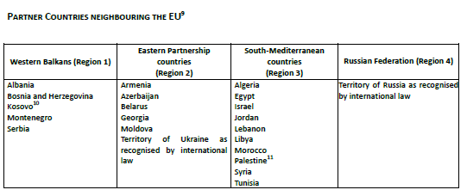
Erasmus+ for Traineeships Programme with partner countries
Development of master curricula for natural disasters risk management in Western Balkan countries
Other partner countries: rest of the world

Slide 24
Erasmus+ for Traineeships Programme with partner countries – Who can take part?
Development of master curricula for natural disasters risk management in Western Balkan countries
Students formally enrolled at Unime (I/II/III cycle of study)
Students formally enrolled in Partner Country’s HEI (I/II/III cycle of study)

Slide 25
Erasmus+ for Traineeships Programme with partner countries – How does it last?
Development of master curricula for natural disasters risk management in Western Balkan countries
Traineeship from 2 to 12 months per cycle
Training activities must concern the student’s course of study

Slide 26

Erasmus+ for Traineeships Programme with partner countries – Student support I
Development of master curricula for natural disasters risk management in Western Balkan countries
Scholarships based on the Hosting Country

Slide 27
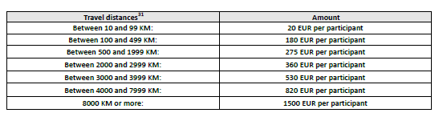
Erasmus+ for Traineeships Programme with partner countries – Student support II
Development of master curricula for natural disasters risk management in Western Balkan countries
Travel contribution based on the EC distance calculator: http://ec.europa.eu/programmes/erasmus-plus/resources_en#tab-1-4

Slide 28
Erasmus+ for Traineeships Programme with partner countries
Development of master curricula for natural disasters risk management in Western Balkan countries
The possibility to realize an internship within the Erasmus+ Programme with Partner Countries is something new as it was introduced by the call for applications published in 2017

Slide 29
Erasmus+ for Traineeships Programme with partner countries – Unime data 2018
Development of master curricula for natural disasters risk management in Western Balkan countries
Our first experience as we have been financed for:
n. 2 outgoing students for traineeships which will be hosted by the University of Skodra and the University of Tirana
The traineeships will start in January 2019

Slide 30
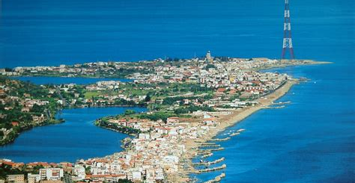
Thank you for your attention
Development of master curricula for natural disasters risk management in Western Balkan countries
Dr. Simona Fazio
University of Messina – European Programmes Unit
email: sfazio@unime.it
email: euprog@unime.it

